Slide 1
Development of website for a Training Organization
Module Project
Module: Front End Web Development
Course: ITSF - Front End Web Development
16/11/2021
Start Date :
End Date : 10/12/2021
Submission Date : 09/12/2021
Learner Name : Joshua Ho Gwok Hin
Enrollment ID : hgh.Joshua@gmail.com
Presentation Date : 10/12/2021

Slide 2
Contents
Contents
1. Project Definition
2. Development Tools
3. Information Architecture
4. Storyboard
5. Menus
6. Business Process
7. Lead Generation Form Design
8. HTML Catalog
9. HTML Pages
10. CSS Classes
11. Lead Generation Form
12. Pages with Styles
13. User Interface Effectiveness
14 Proposed Changes to User Interface
15. Project Deliverables
16. Project Environment
17. Website Review & Improvements
18. Project Milestones & Tasks
19. Milestone Feedback & Action Taken
20. Project Results
21. Proposed Improvements

Slide 3
1. Project Definition
The brick-and-mortal business model has been the mode of operation for ABC Learning Center. The company is looking to benefit from the integration of Web Technologies into the business with a website. Currently, leads were generated from traditional marketing channels like billboards and flyers. As with many traditional marketing methods, printed content gets outdated easily. Discrepancies in delivered content (especially when multiple versions of flyers are being distributed) can take up a lot of time for clarification with the administrative staffs.

Slide 4
1. Project Definition
With implementation of the website for ABC Learning Center, the company can have enhancement on several aspects of the operations. Other than establishing an online presence, the company can now share the most updated content to be delivered to users. Users can now get concise and up-to-date information without the limitations of traditional marketing methods.
One of the main objectives of the website is to allow users to register interest for courses. Gathering leads of validated inputs onto a single location is now a walk in the park. Users can go to the registration page (register.html) from anywhere of the website and key in their particulars. The submit button will then activate the validation of inputs entered and will prompt users to double check their input if validation fails.
Only validated data are being fetched and recorded onto the admin.html page. This Registrants page is specifically designed for administrative purposes where data can be added, amend and delete. This automation of data collection and validation makes organizing leads simple.
Scope of the project
Display the content relevant to the courses
Lead Generation form
Lead Administration
Out of Scope:
Not integrated with database
Responsiveness

Slide 5
2. Development Tools
Development Tools used for this Project
Type | Tool
Operating System (OS) | Windows 11
Integrated Development Environment (IDE)/Editor | Studio Code
HTTP server to run webpages | Apache HTTP Server 2.4.51
Server to run JSP files on webpages | Apache Tomcat 9
Java Runtime Environment | JDK 1.8.0
Web Browser | Edge, Chrome & Firefox
JavaScript Library | jQuery 3.6.0, jQuery UI 1.13.0

Slide 6
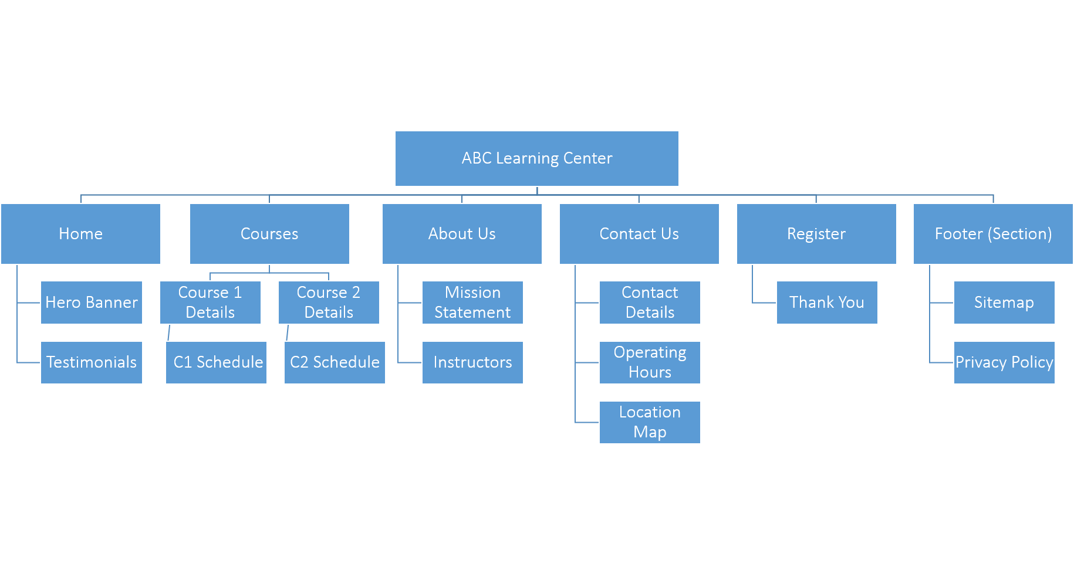
3. Information Architecture

Slide 7
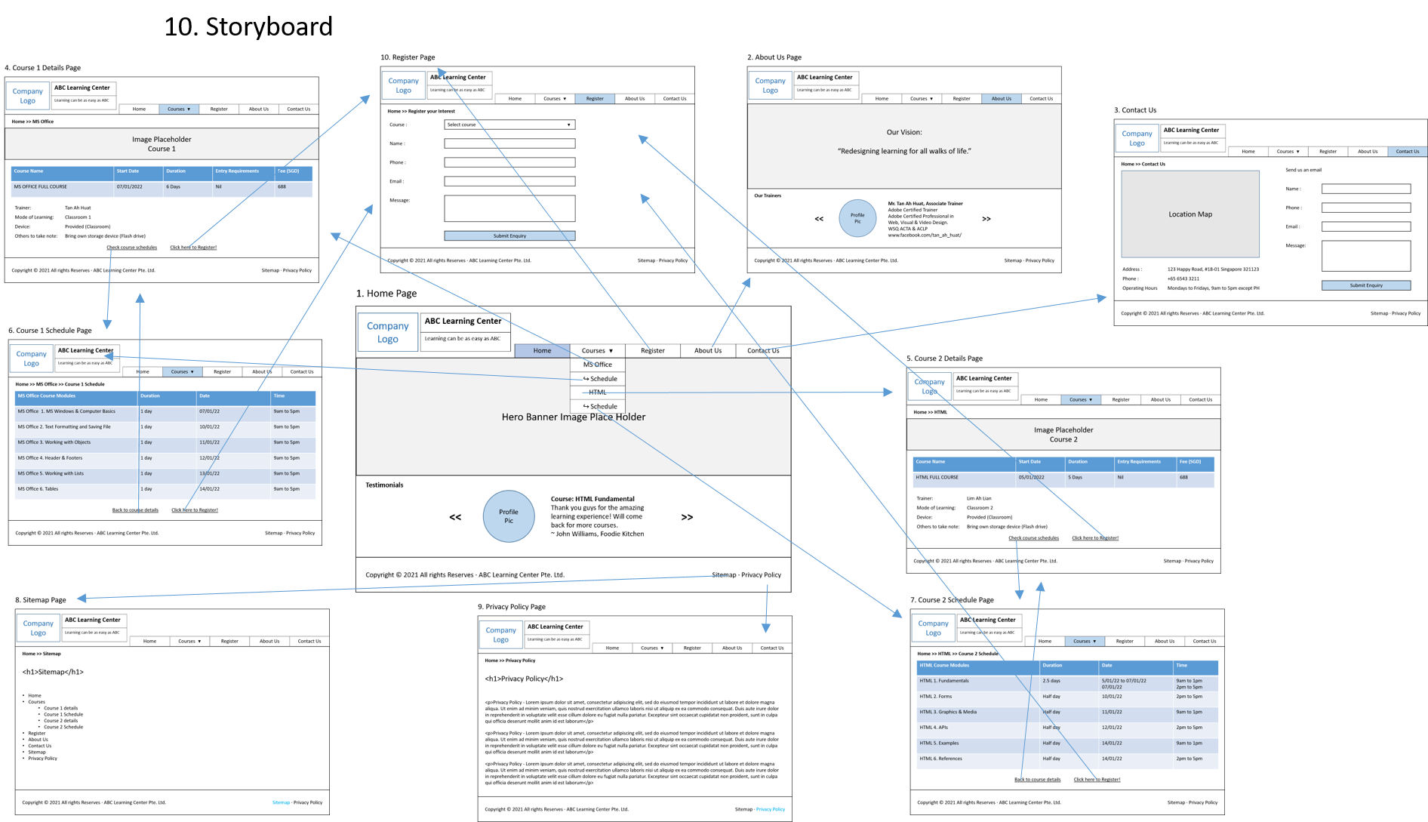
4. Storyboard

Slide 8
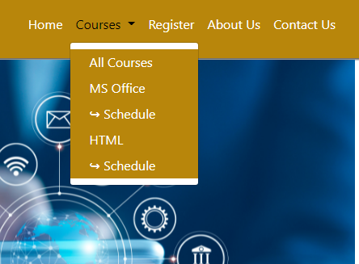
5. Menus
Home – Landing Page
Courses – Listing of all courses
MS Office – Course 1 Details
Schedule – Course 1 Schedule
HTML – Course 2 Details
Schedule – Course 2 Schedule
Register – Register for Courses form
About Us – Hero Banner & Trainers
Contact Us – Location Map & Address.
Tel and Email form.

Slide 9
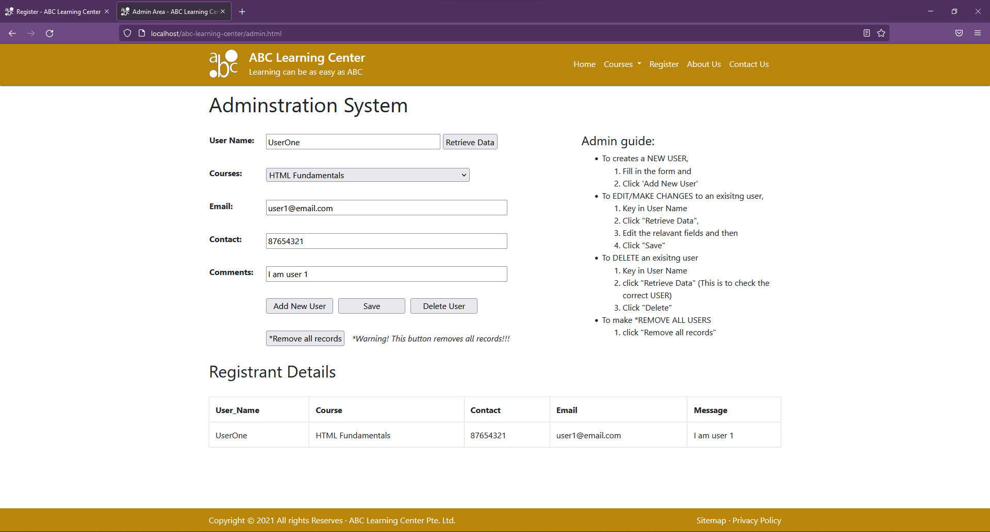
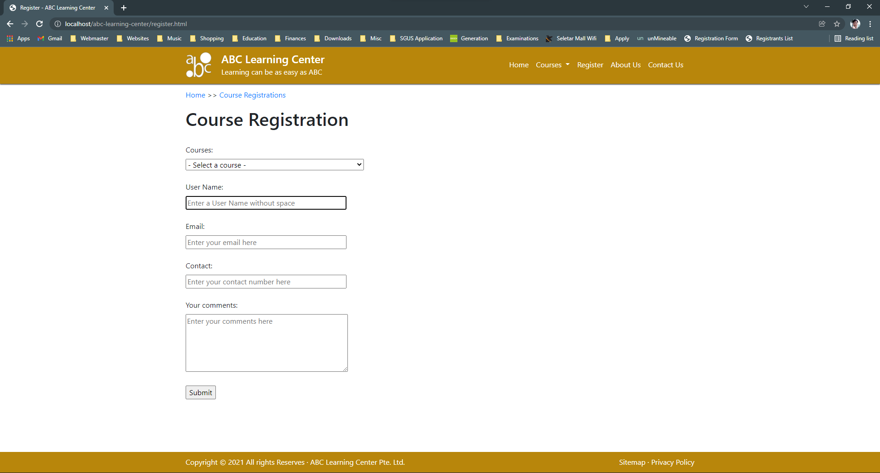
6. Business Process
Add users
Edit users
Save changes
Delete users
Storage
Admin
Visitor
Register

Slide 10
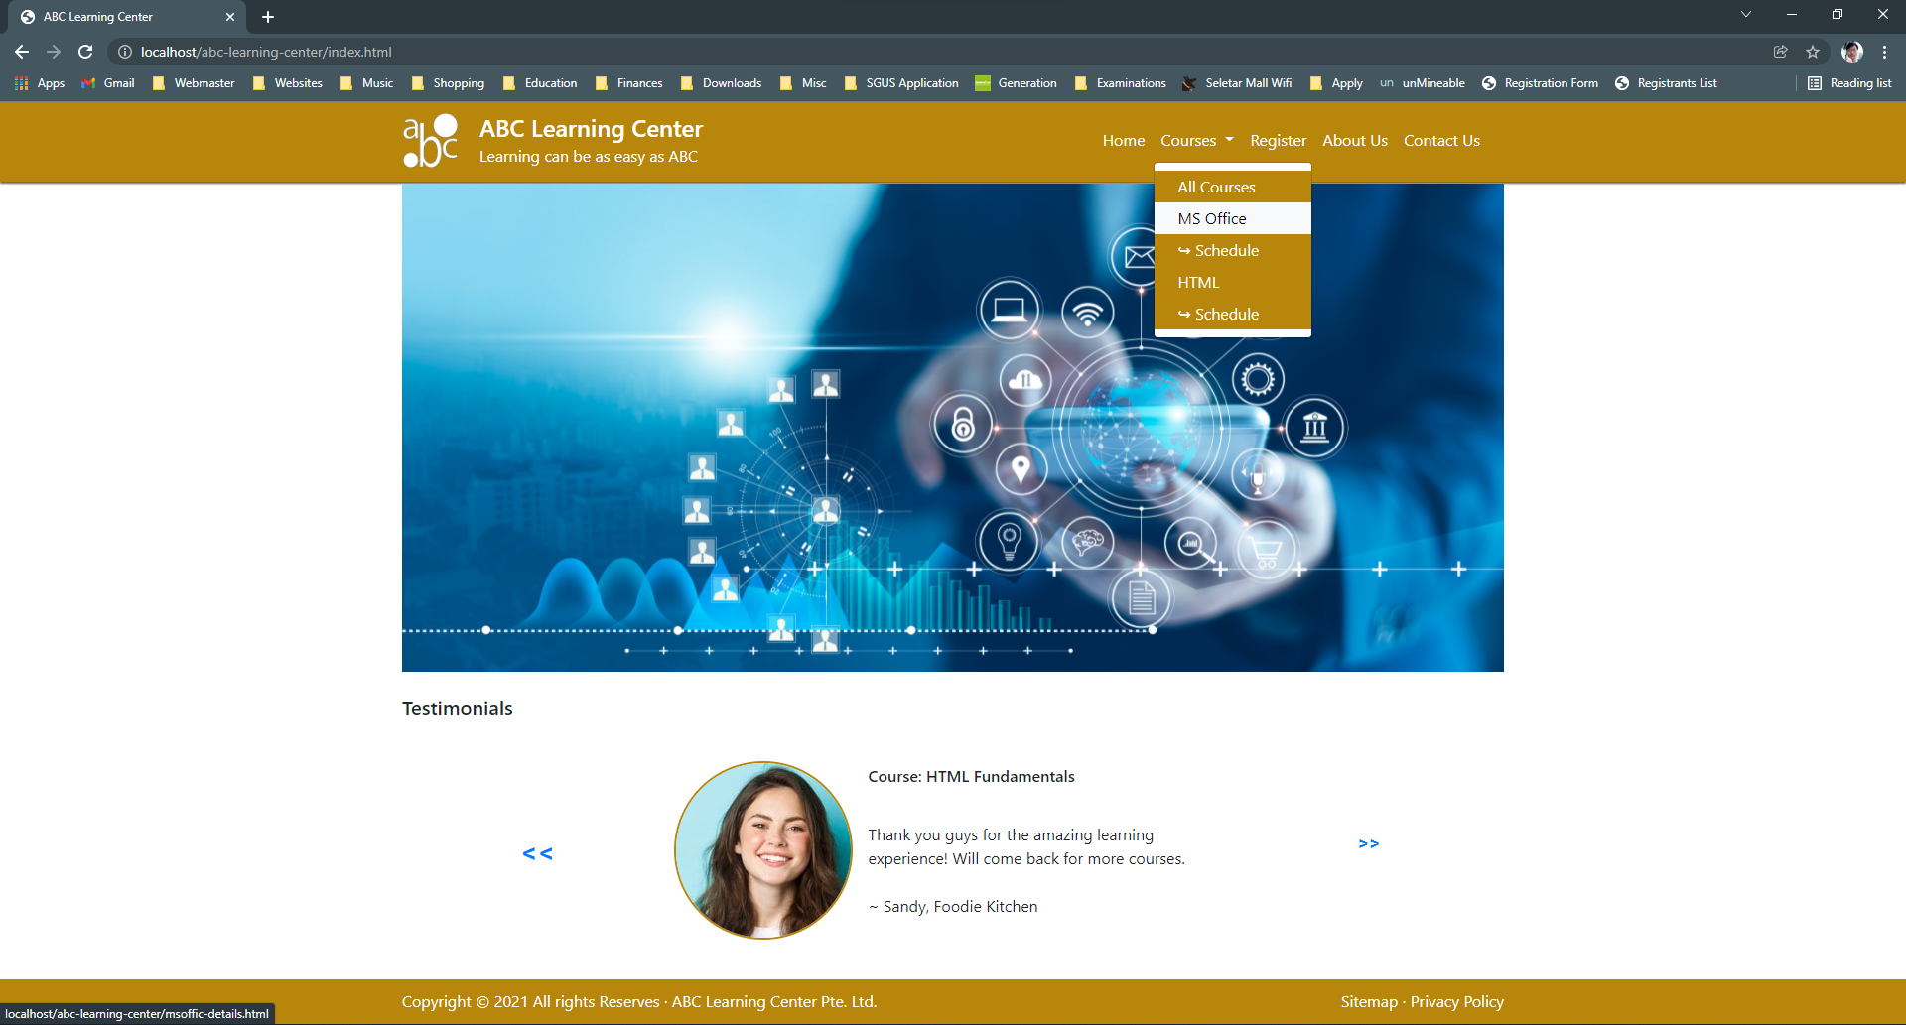
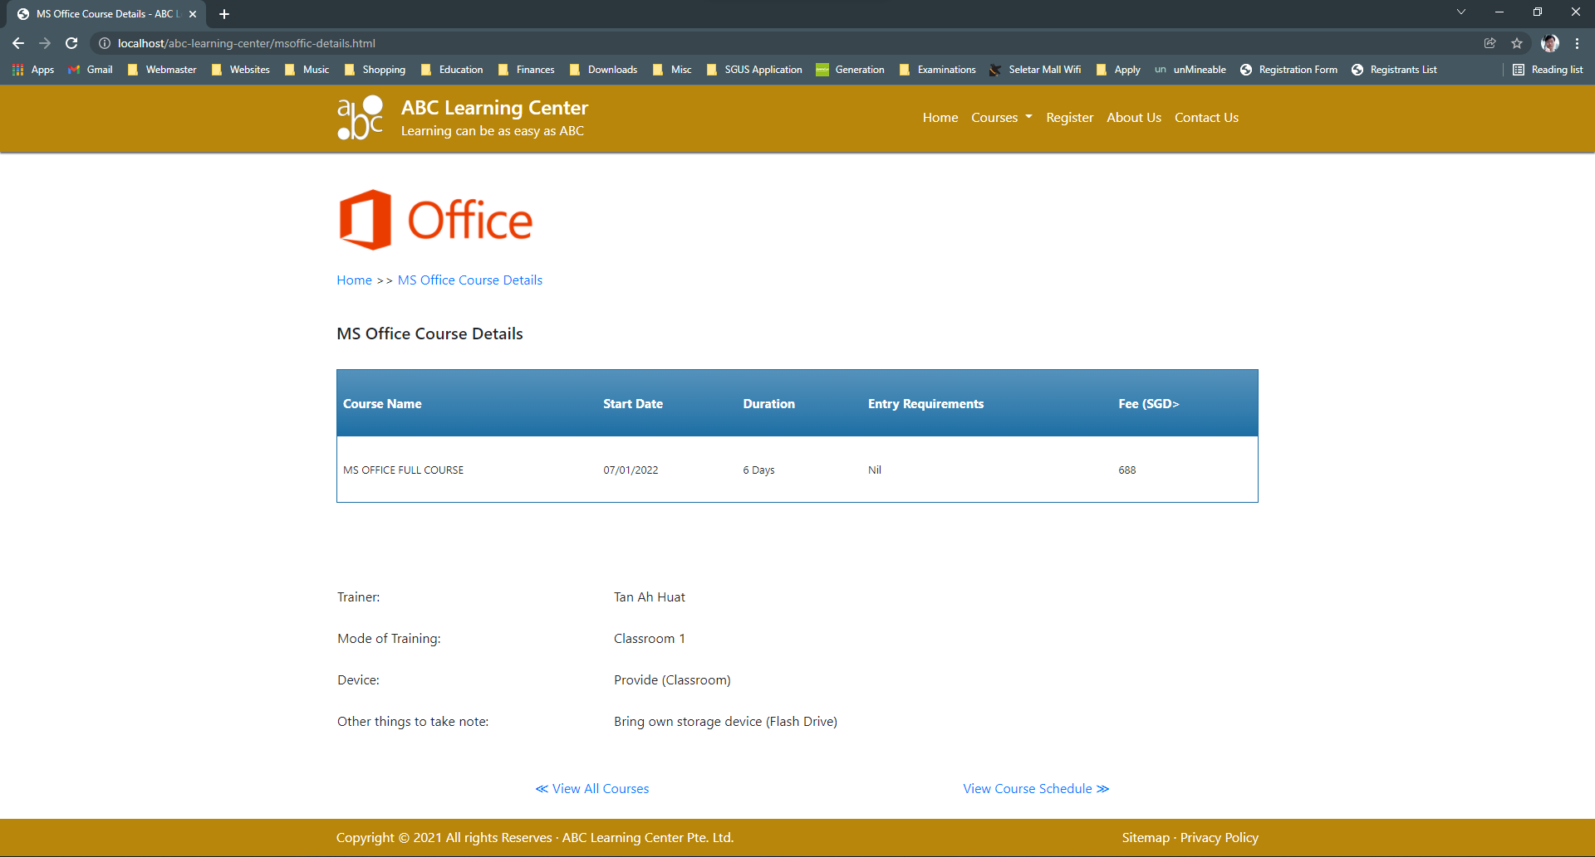
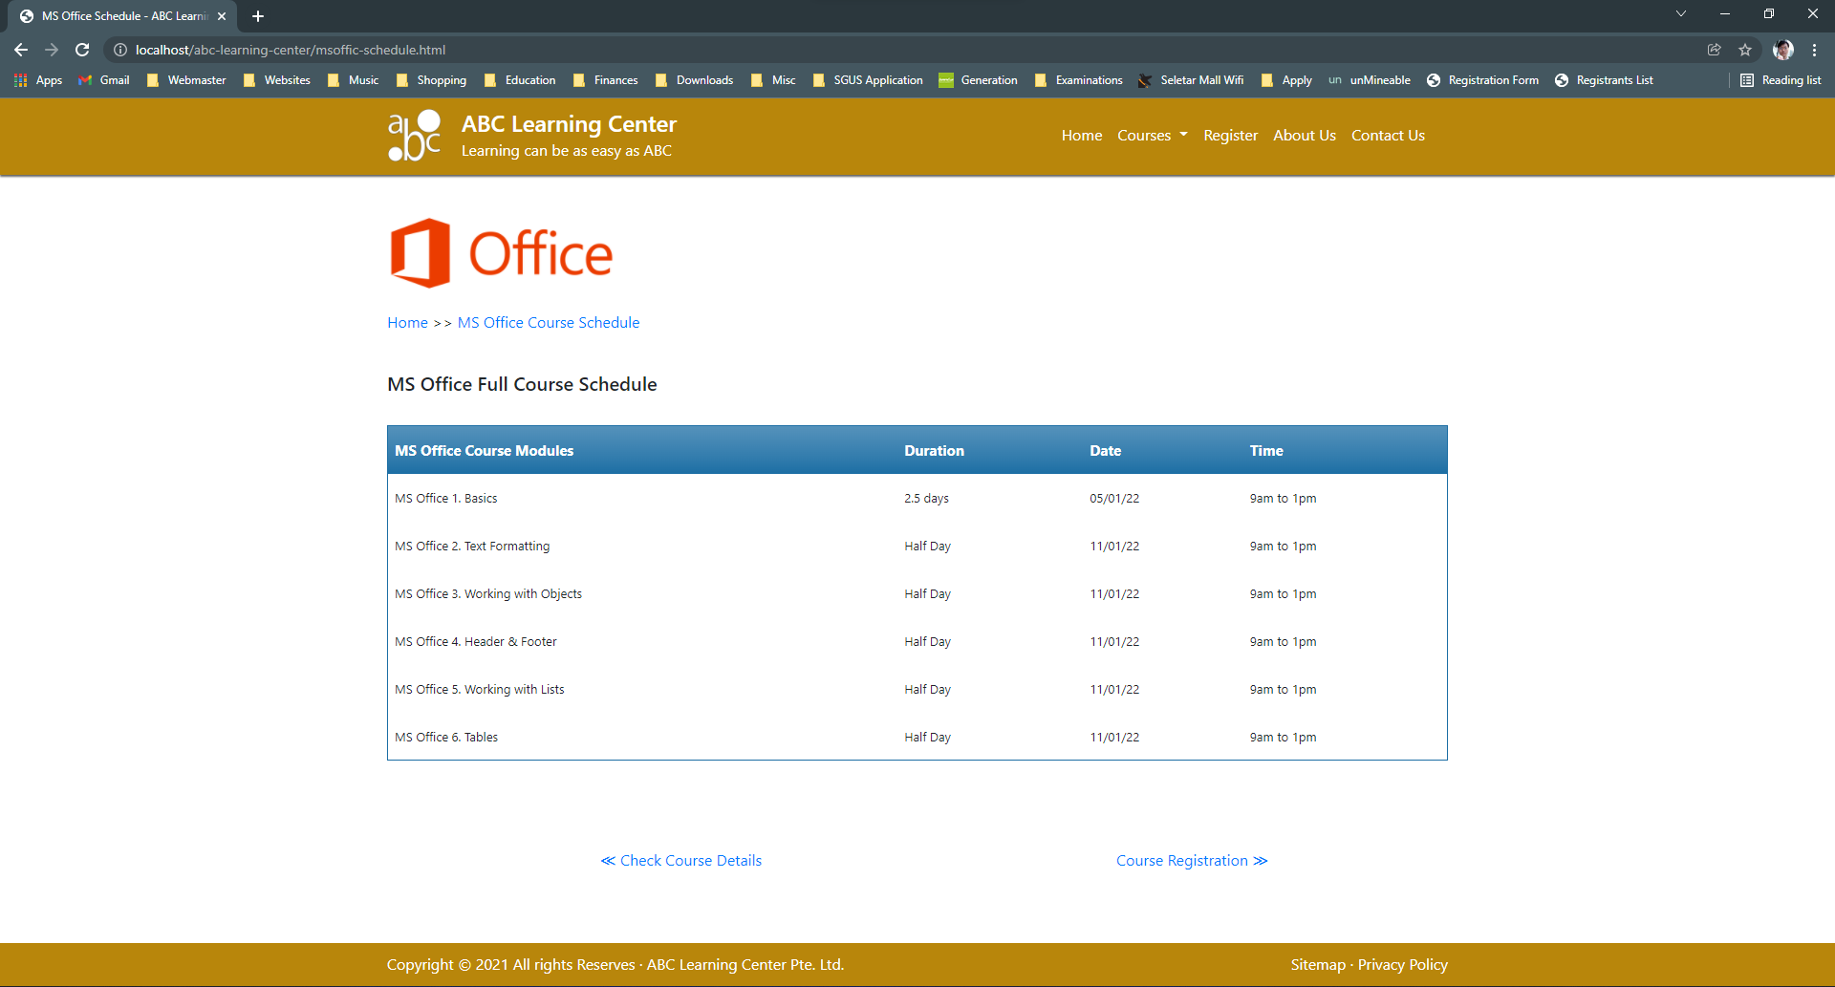
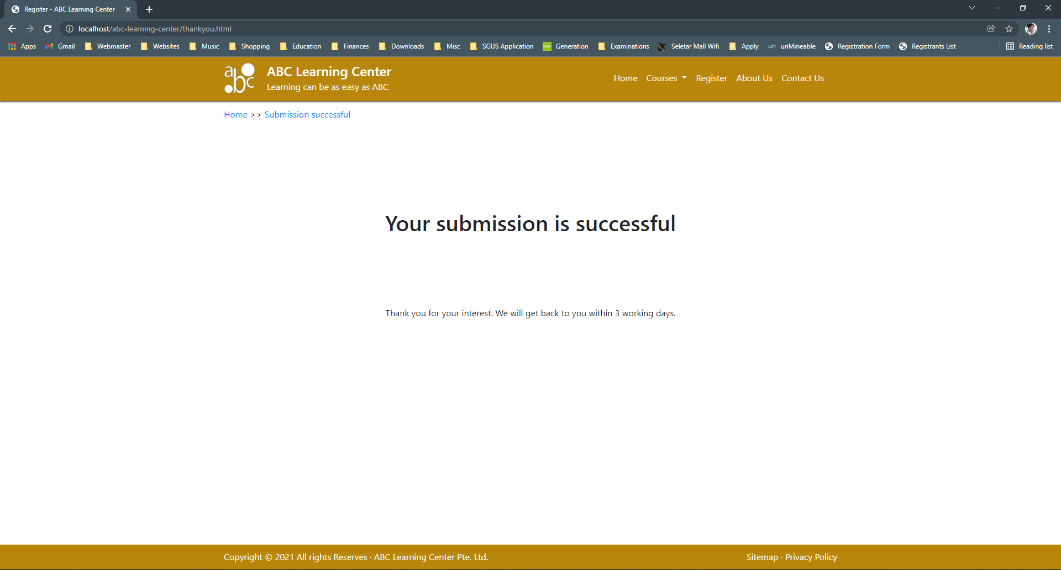
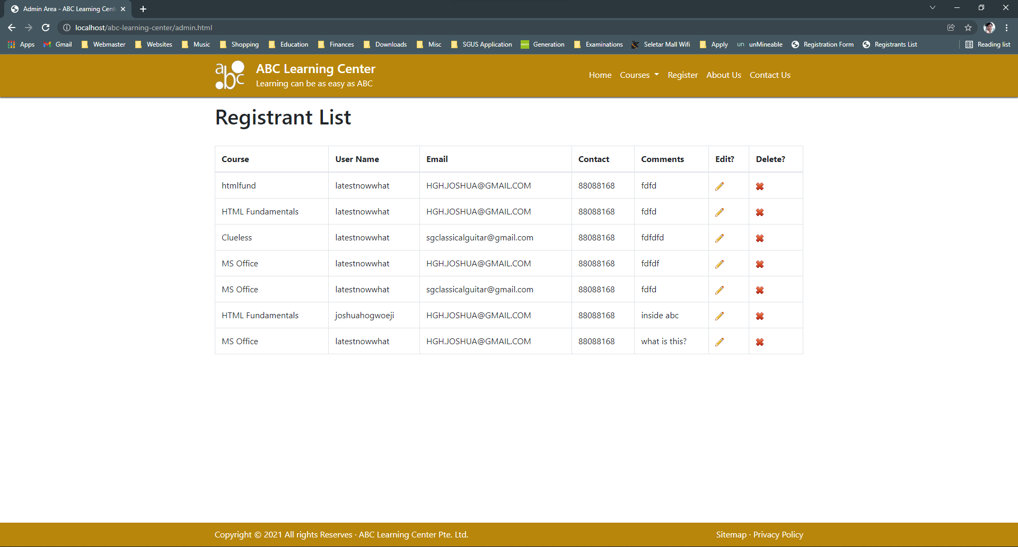
6. Business Process

Slide 11
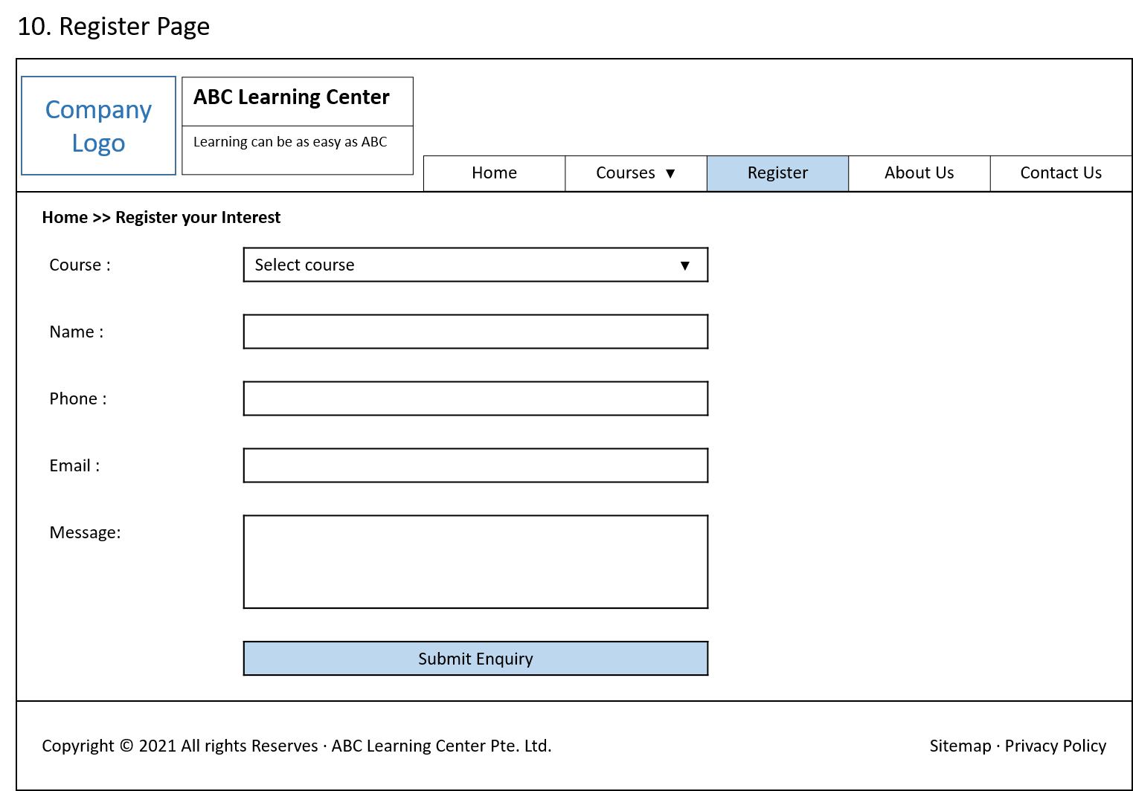
7. Lead Generation Form Design

Slide 12
8. HTML Catalog
List of HTMLs to be developed
Pages | Information
template.html | Template of all common elements before developing other pages.
index.html | Landing Page - hero banner & testimonials
about.html | Hero banner & trainers
courses.html | Lists of all available courses
register.html | Form to collect leads for interested applicants
contact.html | Location Map, Address, Tel & Email form
msoffic-details.html | Course Details of the MS Office Course
msoffic-schedule.html | Course Schedules of MS Office Course
html-details.html | Course Details of HTML Fundamentals Course
html-schedule.html | Course Schedules of HTML Fundamentals Course
thankyou.html | Validate Successful page/ Registration complete confirmation.
header.html | Common Header
footer.html | Common Footer
sitemap.html | List of links of all visitor pages
privacypolicy.html | Privacy Policy of using the website.

Slide 13
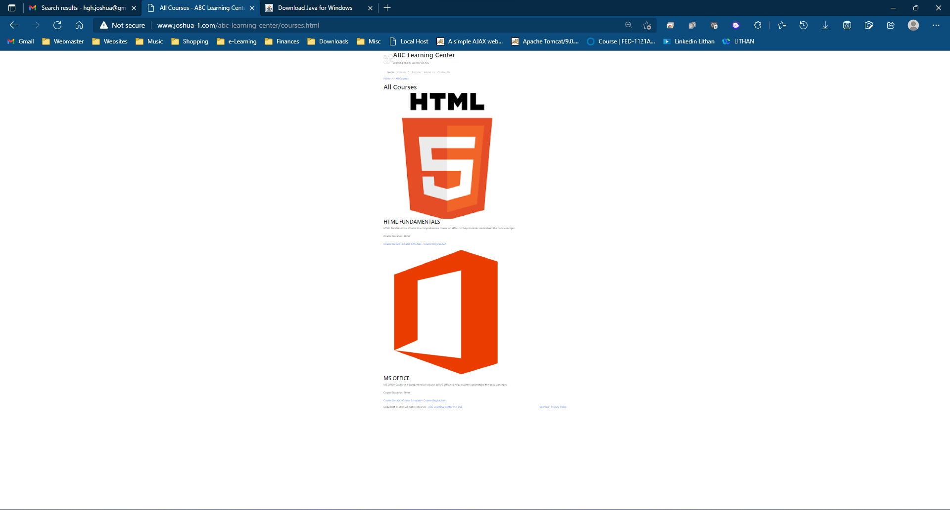
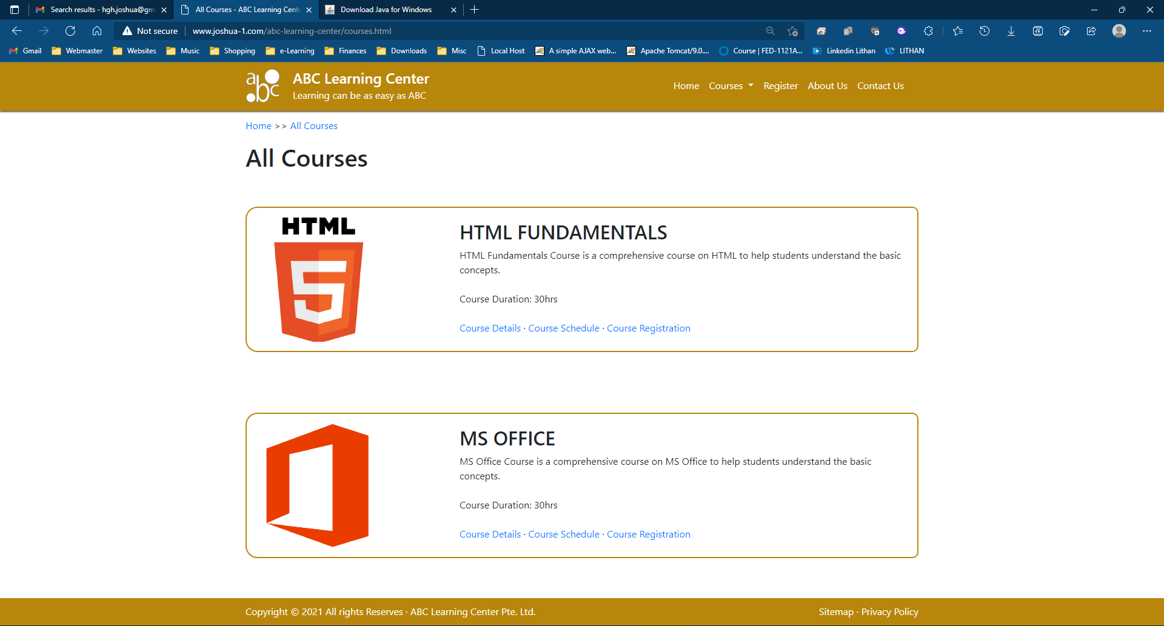
9. HTML Pages
Page name: courses.html
courses.html without CSS
courses.html with CSS

Slide 14
10. CSS Classes
CSS Selectors (except class selectors)
S. No. | Selector | Style to be Created
1 | * { font-family: 'Segoe UI', Tahoma, Geneva, Verdana, sans-serif; } | Changes default font
2 | h1 { font-size: 50px; text-align: center; padding-top: 60px; } | Adjusts the Header 1 font format
3 | p { font-size: 16px; } | Standardise paragraph to 16px
4 | #toAhLianImg img { border-radius: 50% !important; border: 2px solid darkgoldenrod !important; } | jQuery image to look like a circle with border to match the header and footer color.
5 | header { width: 100%; height:80px; background-color:darkgoldenrod; color: white; margin: 0 0 2px 0; padding:0; box-shadow: 0px 2px 2px rgb(100, 100, 100); } | Fill the header with darkgoldenrod color to 100% of the browser width, color the text to white color, set the height of the header to 80px, leave a 2px margin-bottom so that the box shadow appears before hero banner.

Slide 15
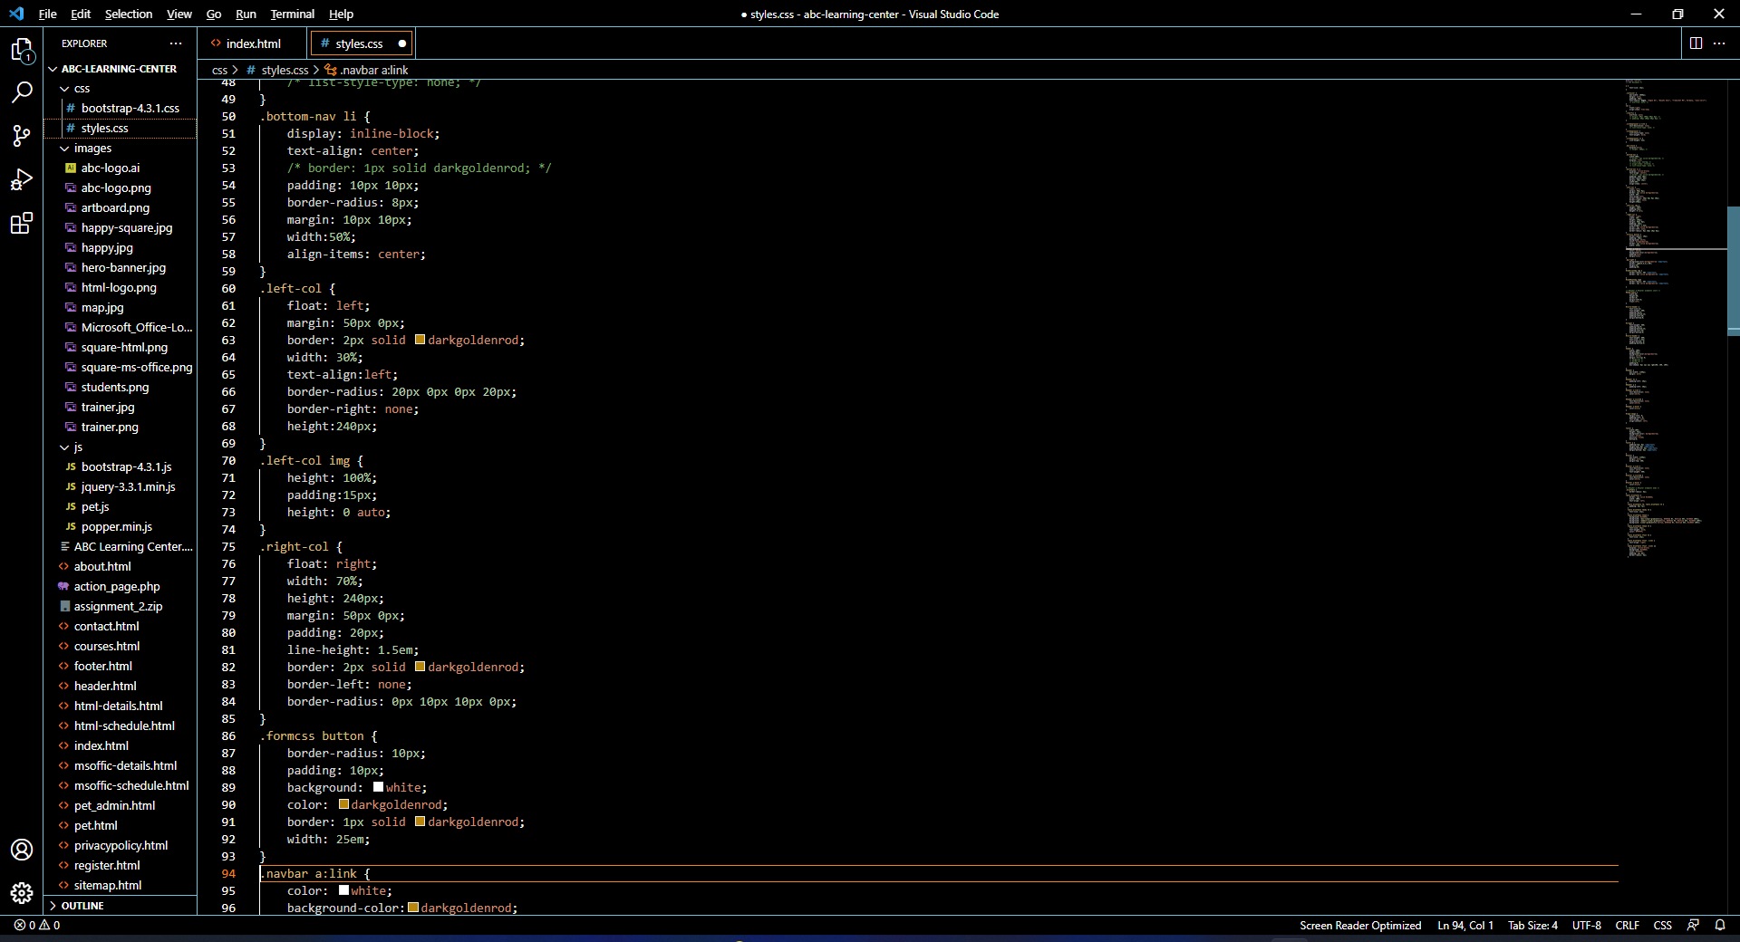
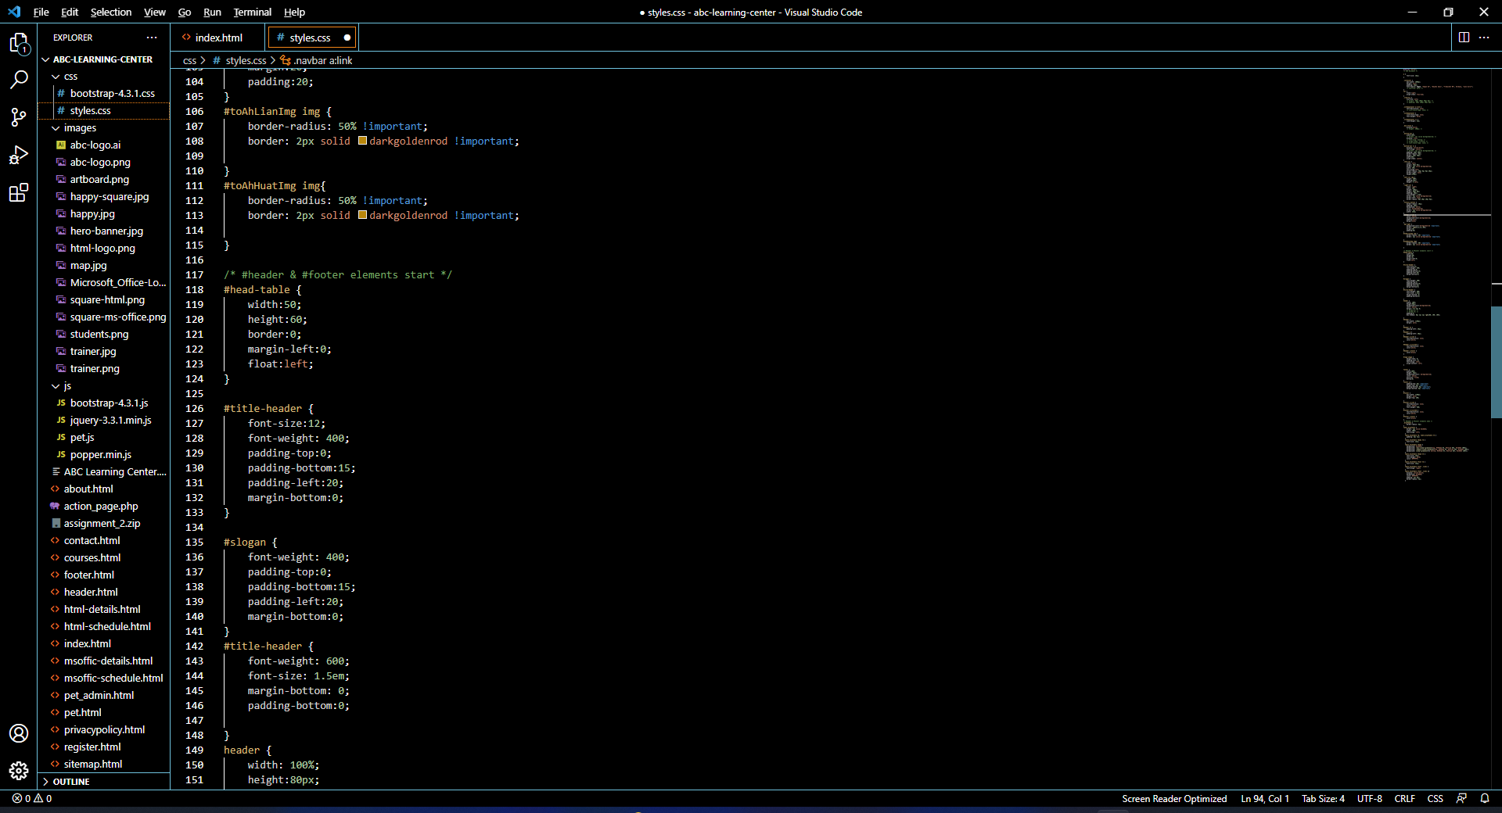
10. CSS Classes
CSS Classes

Slide 16
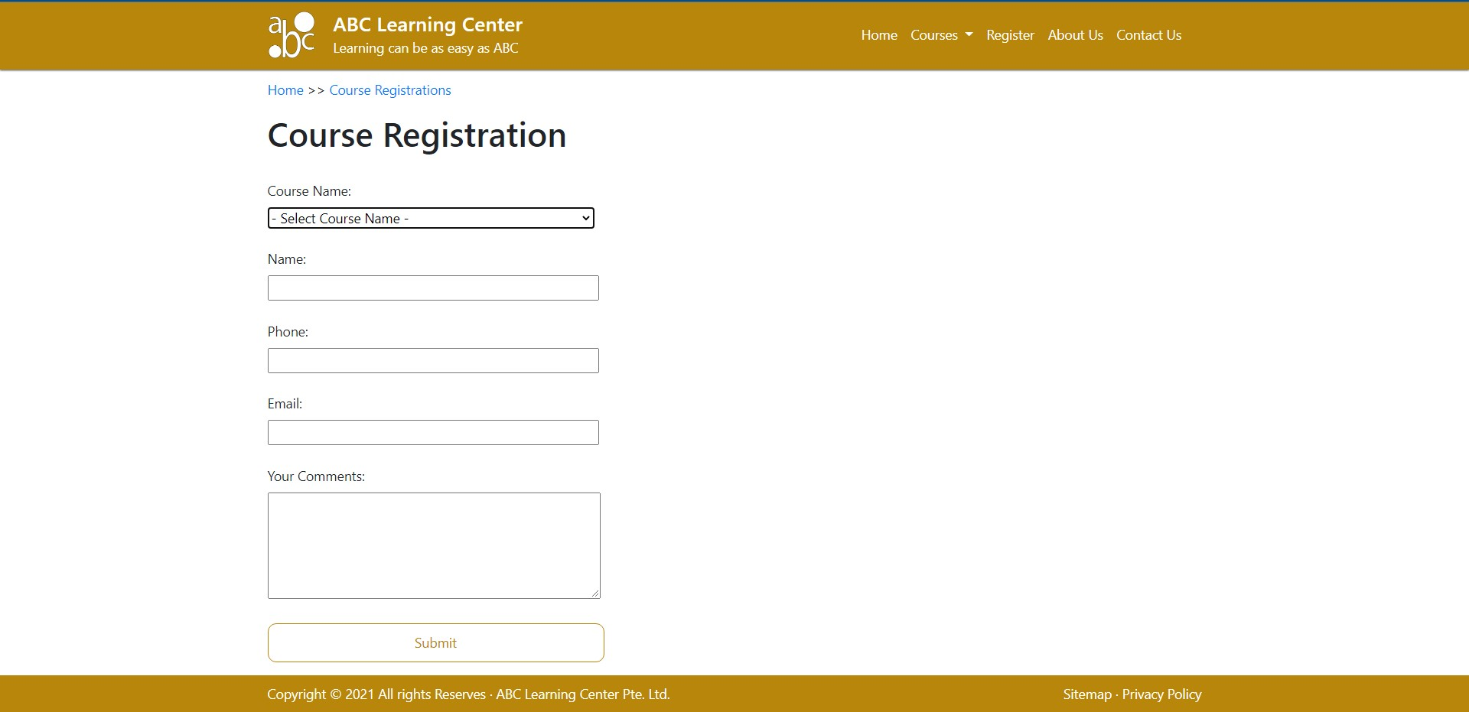
11. Lead Generation Form

Slide 17
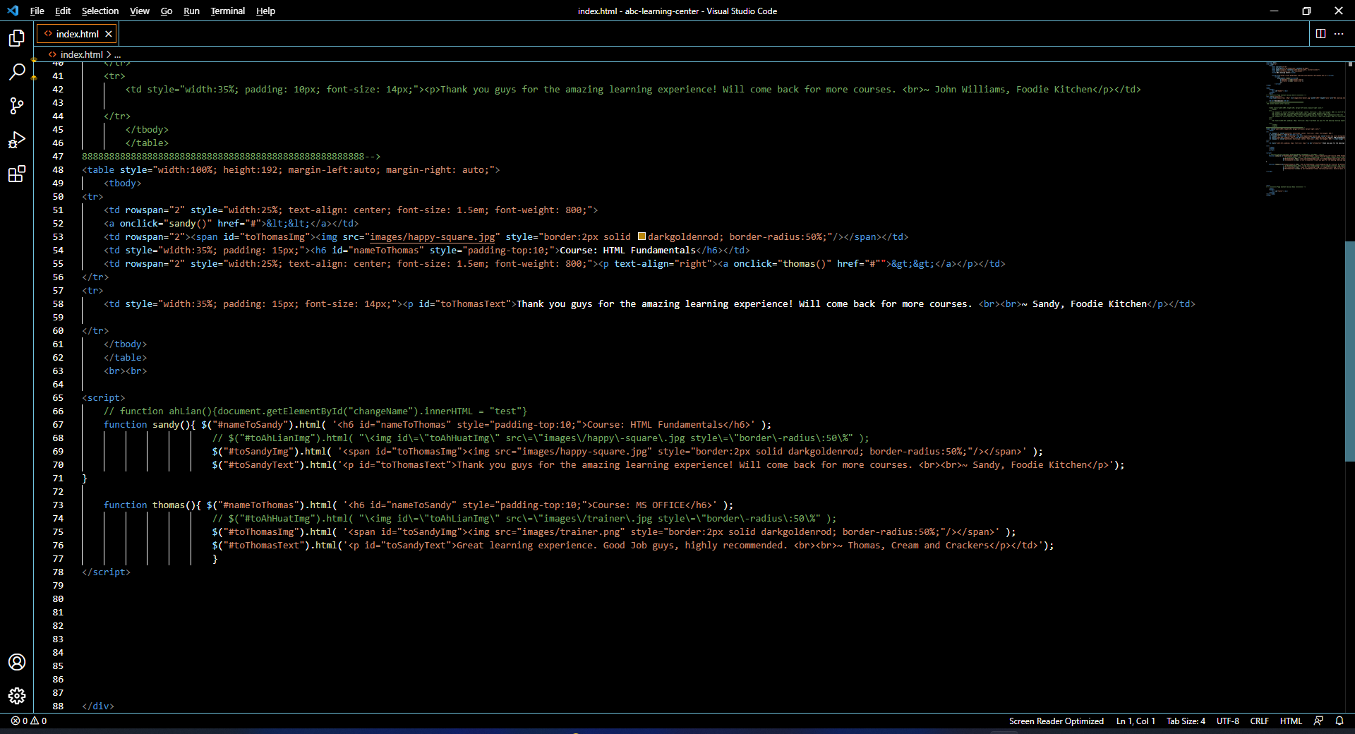
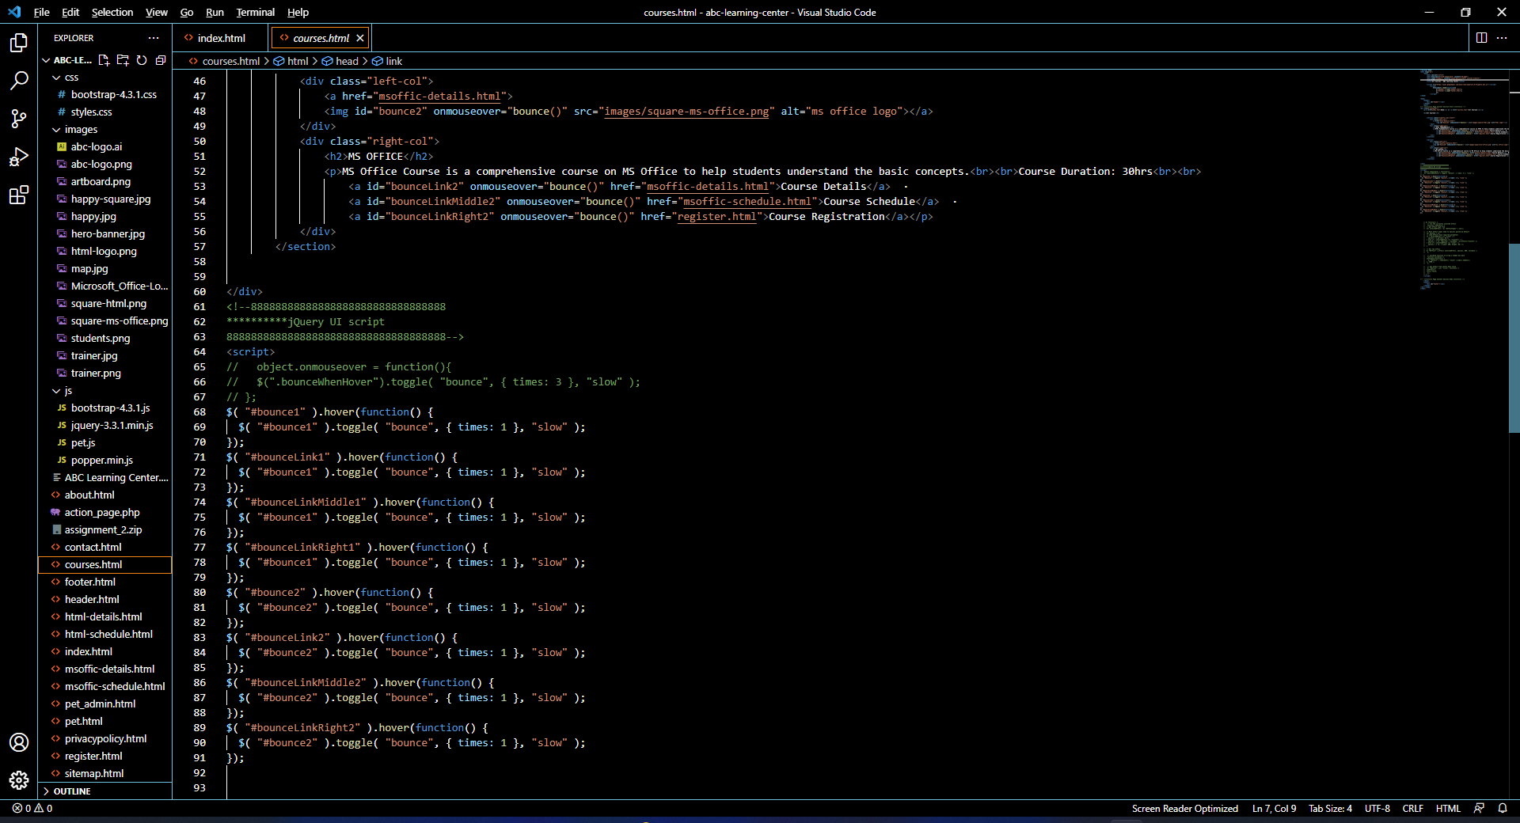
12. Pages with Styles

Slide 18
13. User Interface Effectiveness
Effectiveness Metrics
Types of metrics:
User satisfaction rate
Task success rate
No. of page clicks
Time needed to complete a task
Metrics 1: 90% increase in user satisfaction
User can find information fast with simple navigation bar. No complicated design.
Metrics 2: 50% increase in task success rate for lead generation.
Lead generation forms have simple design with less than 5 input fields. Most of which comes with simple instructions should validation fails.

Slide 19
14. Proposed Changes to User Interface
Proposed Changes
Add some CSS transitions for to make it more lively.
Add more shadow for more dimensional look.
Fluid layout to support smaller devices.
Outbound social media page links to encourage interactions via FB, Tweeter, LinkedIn, and etc.
Social media plugins for official page contents to be displayed on the website

Slide 20
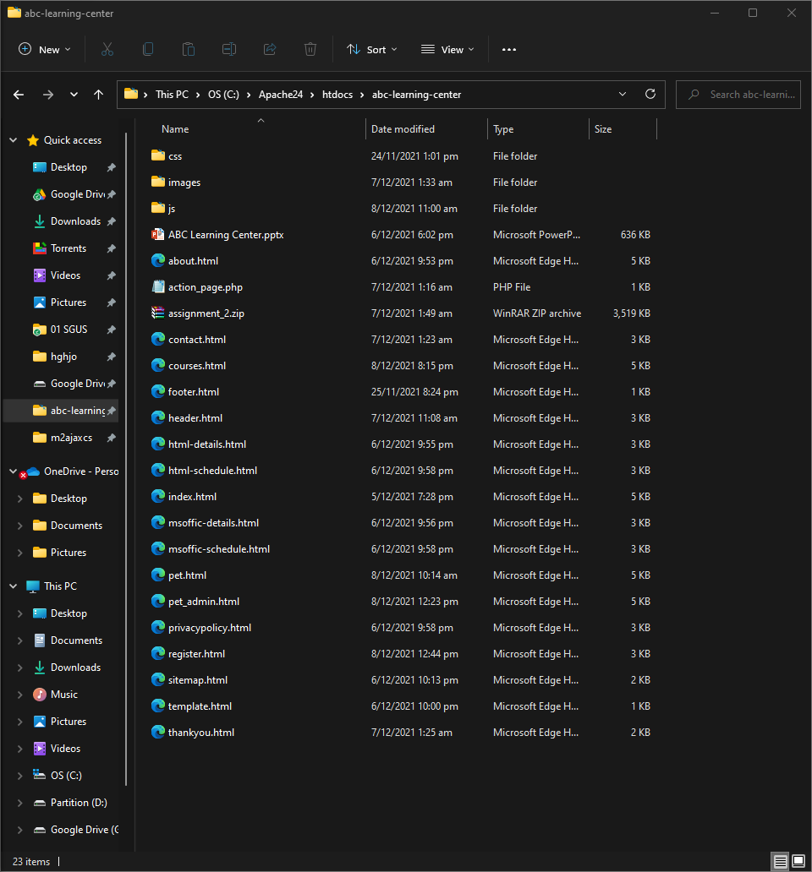
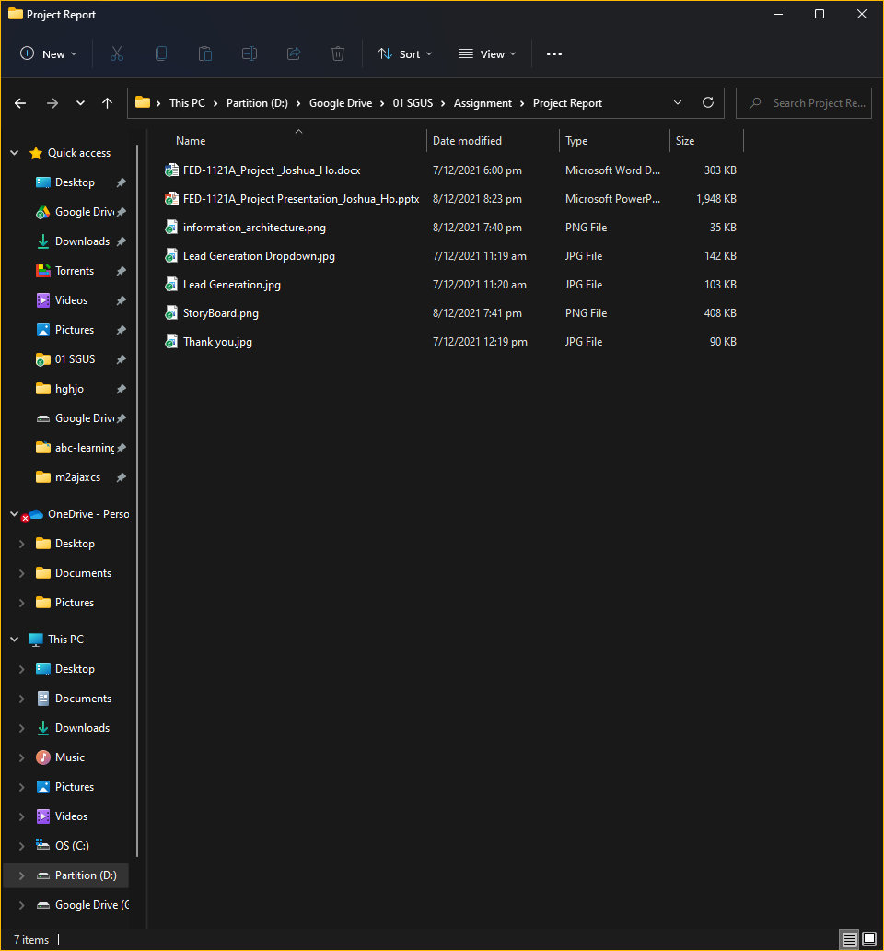
15. Project Deliverables
Project Deliverables
Evidence
HTML pages
CSS files
Project Report
Project Presentation
Source Code

Slide 21
16. Project Environment
Technical Environment and Tools Used
List of references
https://htmlcheatsheet.com/
https://www.w3schools.com/
https://jqueryui.com/
Software: Development environment: JDK1.8
Tomcat 9/ Apache 2.4.51
Editor: Visual Studio Code & Dreamweaver 2020
Programming languages: JavaScript
Hardware: Client server
Client (User) – Windows– Windows 11
Server (Hosting Environment) – Windows Server

Slide 22
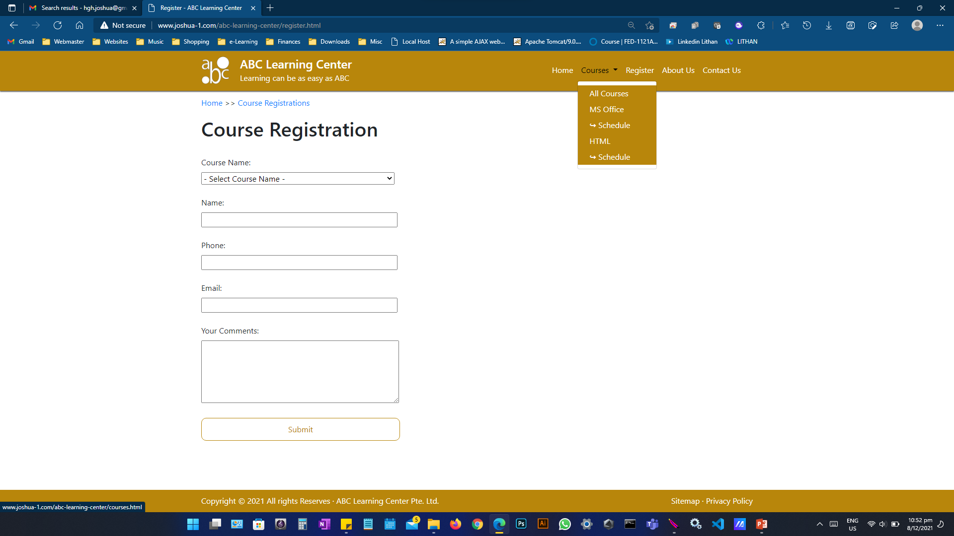
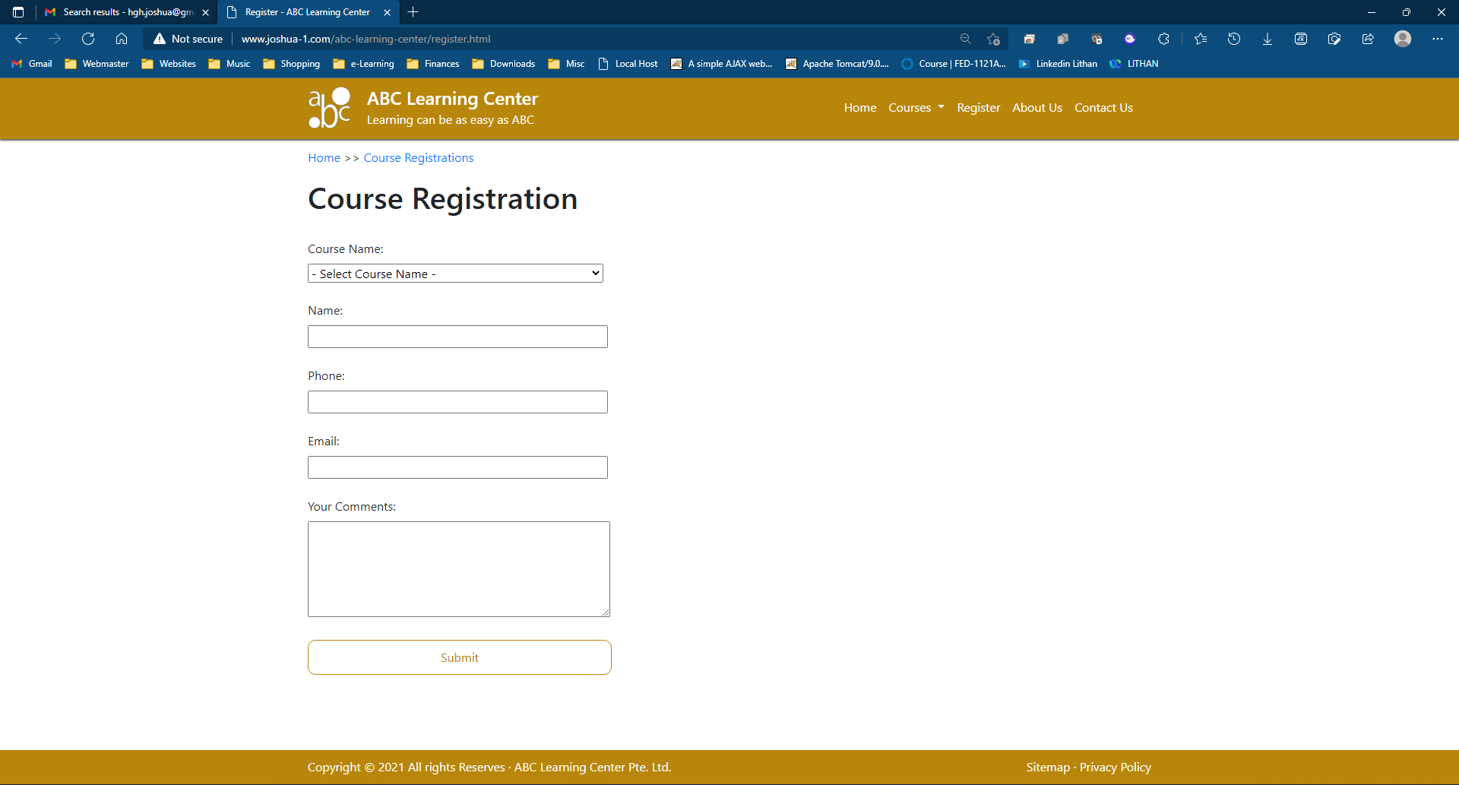
17. Website Review & Improvements
 | Pros | Cons
Item | Simple design, easy to navigate. | Too plain, boring looking.
Description | Users can navigate to any user pages in 2 clicks or less. Most are accessible from the right side. | Other than black and white, only 1 color is used.
Display |  | Can have more shadows or group of color palette.

Slide 23
18. Project Milestones & Tasks
Project Task ID | Project Task Description | Project Milestone ID
1 | Completion of Information Architecture, Storyboard, Wireframe | 1
2 | Completion of HTML | 1
3 | Completion of CSS and JavaScript | 1
4 | Completion of Lead Generation Form and Administration | 1
5 | Website Testing | 1
6 | Website Testing as a whole on Apache Tomcat | 2
7 | Completion of Project Report | 2
8 | Completion of Project Presentation | 2
9 | Submission of Project Report | 3
10 | Submission of Project Presentation | 3
11 | Submission of Source Code | 3

Slide 24
19. Milestone Feedback & Action taken
Project Milestone ID | Milestone Feedback received from Tutor / Learning Facilitator | Action Taken (Yes / No)
1
2
3

Slide 25
20. Project Results
Link for the project
www.joshua-1.com/abc-learning-center/
Or
localhost/abc-learning-center/

Slide 26
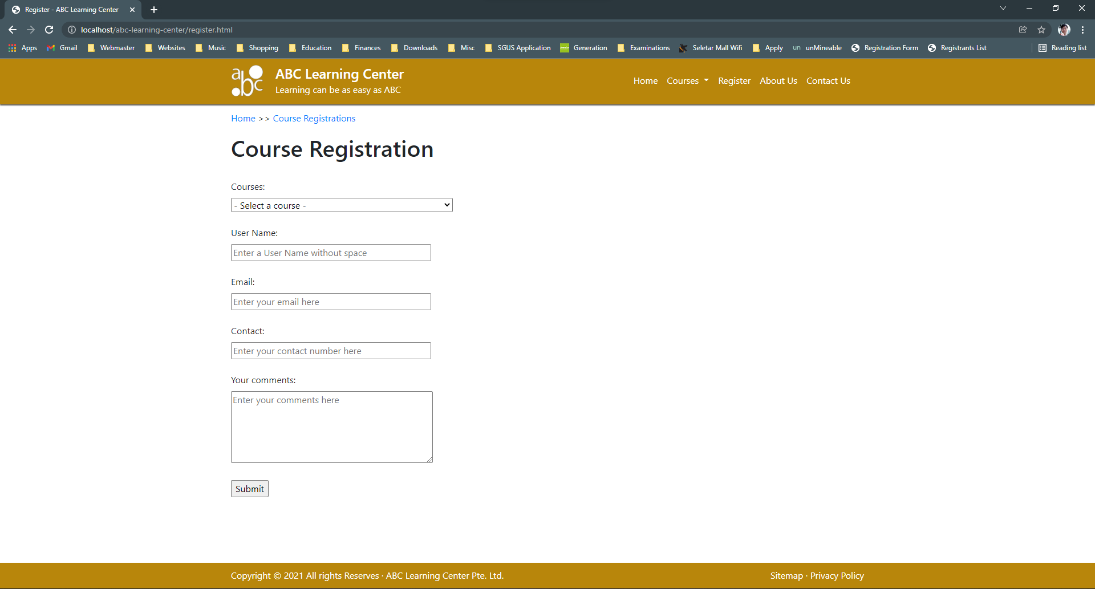
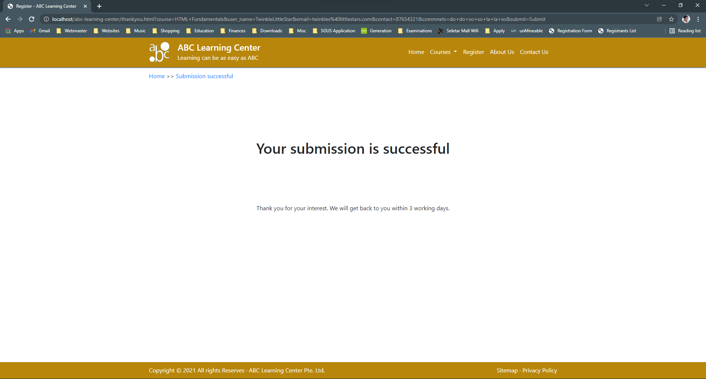
20. Project Results

Slide 27
21. Proposed Improvements
List of Improvements
Add more colours and/or shadow in the HTML elements to look more dimensional.
CSS can be improved with less redundant and duplicated classes.
A lot of inline styling can be reduced with external CSS.
More animation in jQuery Objects
More effects with CSS transition
Remove duplicated internal and external stylesheets, JavaScript
More styling in online forms

